Slide 1
Data Visualization & Interpretation
Febin.A.Vahab

Slide 2
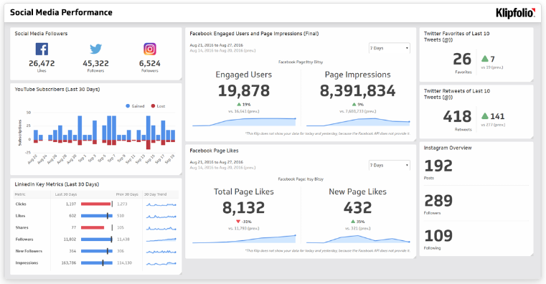
Adapted from: Social Media Performance Dashboard, https://www.klipfolio.com/resources/dashboard-examples/social-media/performance

Slide 3
Session -Agenda
Information Dashboard
Definition
Three 3’s
Characteristics
Effective Design Strategies
Common Dashboard Design Mistakes
Design issues
Display issues
Data issues

Slide 4
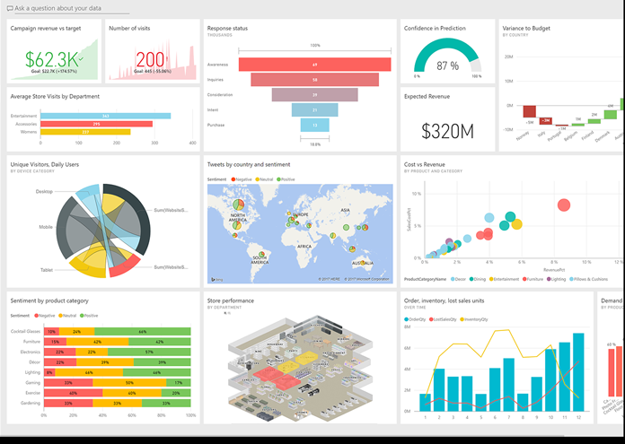
Information Dashboard
A performance dashboard is a layered information delivery system that parcels out information, insights and alerts to users on demand so they can measure, monitor and manage business performance more effectively.
-- Wayne Eckerson

Slide 5
Information Dashboard
Definition
A dashboard is a visual display of the most important information needed to achieve one or more objectives; consolidated and arranged on a single screen so the information can be monitored at a glance.

Slide 6
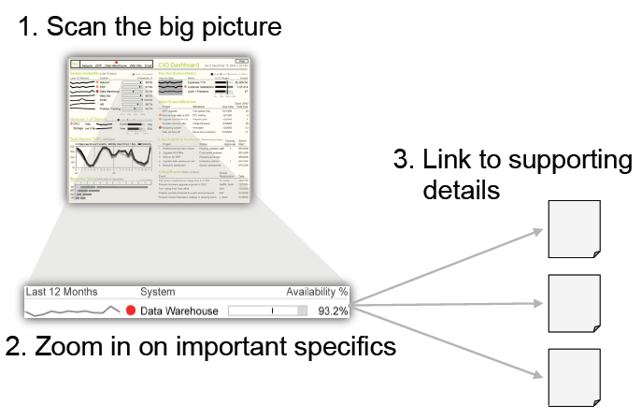
Visual monitoring

Slide 7

Dashboard Characteristics
Visual Displays
Displays information needed to achieve objective
Fits on single computer screen
Displays information in web browser
Monitors information at a glance
Small, clear, intuitive display mechanisms
Customized

Slide 8

Three 3’s
Three 3’s
Three Applications
Three Layers
Three Types

Slide 9
Three 3’s
Three Applications
Management
Foster collaboration and decision making
Support executive meetings
Monitoring
Monitor performance against metrics defined
Operational processes
Analysis
Allows exploration of data across many dimensions
Helps to identify the root cause of exceptional conditions

Slide 10
Three 3’s
Three Applications
 | Monitoring | Analysis | Management
Purpose | Provide information at one sight | Observe exceptions and drill to detail | Decide and refine business strategy
Consists of | Dashboard Scorecard BI Portals Alerts | OLAP Reporting Ad hoc queries | KPIs

Slide 11
Three 3’s
Three informational Layers
Summarised / KPI data
Dimensional data
Detailed data

Slide 12
Three 3’s
Three Layers
Visuals
Dimensions
Details

Slide 13
Three 3’s
Three Types
Strategic Dashboards
Tactical Dashboards
Operational Dashboards

Slide 14
Three 3’s
Strategic Dashboard
Implemented as scorecards
Monitors execution of strategic objectives
Used for review performance by high level executives

Slide 15
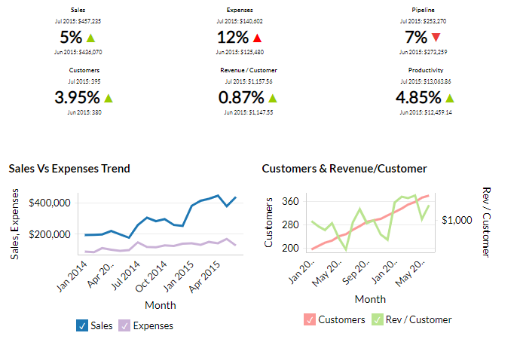
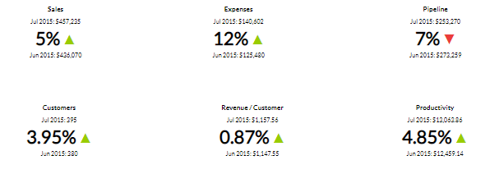
Strategic Dashboard

Slide 16
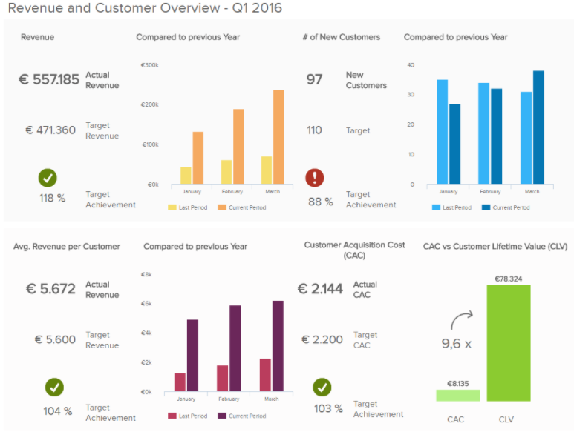
Strategic Dashboard

Slide 17
Three 3’s
Tactical Dashboard
More emphasis on analysis
Uses multidimensional view of data
Monitor and manage departmental processes and projects

Slide 18
Thank You!

